Slide 1

ROAD TRAFFIC ACCIDENTS IN NIGERIA: DATA-DRIVEN PUBLIC AWARENESS PROJECT
BY
HELEN OREOLUWA MEDASE
AN ANALYSIS USING SQL AND POWER BI

Slide 2
INTRODUCTION
Road traffic accidents remain a major concern in Nigeria, causing significant loss of lives and economic damage. This project aims to analyze available data to uncover trends and pattern that contribute to the high accident rate.
The goal is to create public awareness dashboard that highlights key insights and promotes data-informed decisions for improving road safety.

Slide 3
OBJECTIVES
Main Objective: To analyze and visualize road traffic accident data in Nigeria in order to identify trends and patterns that can help raise public awareness and support road safety initiatives.
Specific Objectives;
To clean and prepare the dataset for analysis using Power query in Power BI
To explore and analyze accident patterns using SQL
To visualize key insights, identify high-risk locations on Power BI dashboards for better understanding
To provide data-driven recommendations for improved road safety awareness

Slide 4
DATASET AND TOOLS USED
Dataset description: This dataset used for this project focuses on road traffic accidents in Nigeria from Q4 2020 to Q3 2024. It contains information on accident occurrences, causes,vehicle type, location(States), number of casualties, people involved, people injured, fatal, serious or minor and the time periods.
Data source: The dataset was sourced online from NBS(National Bureau of Statistics) and compiled by FRSC.
Tools Used;
SQL for Data exploration and analysis through queries
Power BI for Data visualization and interactive dashboard creation

Slide 5
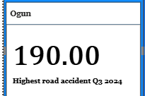
INSIGHT AND VISUALIZATION 1
The highest number of accidents in Q3 2024 was Ogun state. The major cause of accidents was SPV(Speed Violation) with 133 cases and LOC(Loss of Control) with 155 case. This is linked together because speed violation can lead to loss of control. This will very likely continue if some measures are not put in place , to curb this effectively;
- Implement targeted road safety engineering such as rumble strips, improved signage and better curve design at known blackspots
-Authorities should enforce the use of speed limiting devices on commercial vehicles and expand automated speed cameras on major highways.

Slide 6
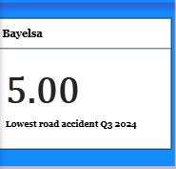
INSIGHT AND VISUALIZATION 2
The state with the lowest recorded number of accident in Q3 2024 is Bayelsa with a total number of 5 cases. There was 2 cases of speed violation and 1 case of loss of control, tyre burst, brake failure, dangerous driving, route violation each. Implementing targeted road safety engineering such as rumble strips, improved signage and better curve design at known blackspots will very most likely reduce the number of accidents futher.

Slide 7
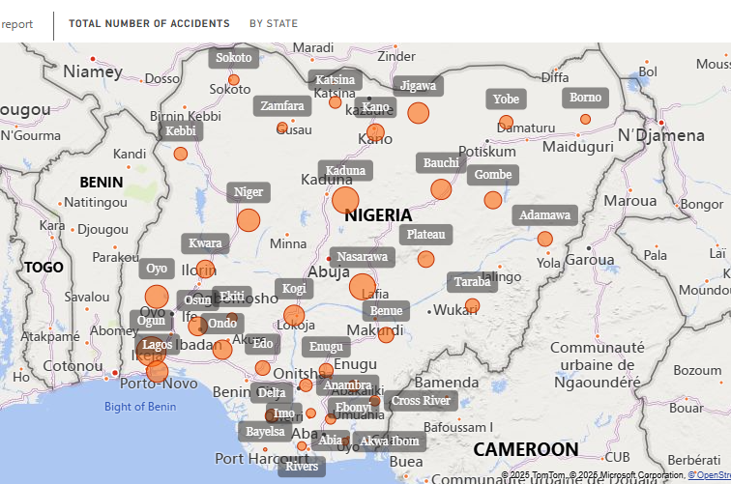
INSIGHT AND VISUALIZATION 3
FCT, Ogun, Nasarawa, Kaduna, Oyo are the state with the highest number of total accidents with 5303, 4149, 3211, 3065, 2346 number of cases respectively with commercial transport being the most vehicle category involved in over 60% of the total accidents through the years. The major causative factors are speed violation, sign light violation, wrongful overtaking, dangerous driving, tyre burst, brake failure and road obstruction violation. The following measures should be used to counter these causative factors;
-Speed violation: speed limiters, speed camera, and traffic calming.
-Sign/light violation: signal timers, red-light camera, awareness
-Wrongful Overtaking: clear markings, no-overtaking zones, driver re-training
-Dangerous driving: patrol enforcement, penalty point, defensive driving
-Tyre burst: regular inspections, ban used tyres, tyre-care education.
-Brake failure: vehicle maintenance checks, inspection centers, load control
-Road obstruction: remove illegal parking/trading, clear debris, proper signage

Slide 8
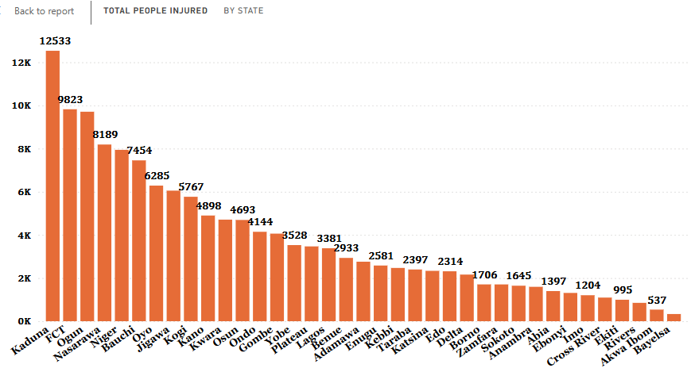
INSIGHT AND VISUALIZATION 4
Kaduna state has the highest number of injured people across all state with 12,533 number of injured people and speed violation identified as the major cause of accident through the years. Following Kaduna is FCT, the Federal capital Abuja, with a total number of 9,823 of injured people and Ogun state comes in third with 9,709 of injured people with speed violation being the major causative factor across all states through the years. More FRSC and other road safety officials should be deployed to the major blackspots to implement these following measures;
-Implement targeted road safety engineering such as rumble strips, improved signage and better curve design at known blackspots
-Authorities should enforce the use of speed limiting devices on commercial vehicles and expand automated speed cameras on major highways

Slide 9
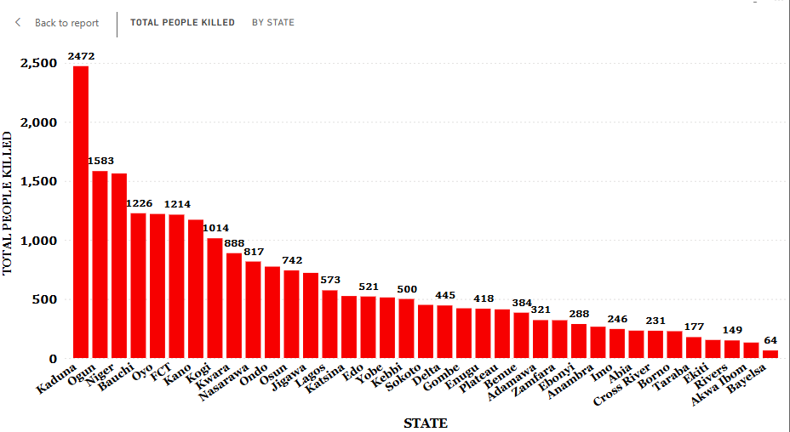
INSIGHT AND VISUALIZATION 5
Kaduna, Ogun, Niger, Bauchi, Oyo, FCT, Kano, Kogi are the states with the highest record of total people killed. Kaduna holds the highest record with 2472 number of people and the remaining states have a record of over 1000 people. Speed violation, wrongful overtaking, tyre burst are the major causes of these accidents in Kaduna through the years. Speed limiters, speed camera, traffic calming, clear markings, no-overtaking zones, driver re-training, regular inspections, ban used tyres, tyre-care education should be put in place and officials should be deployed to enforce these measures and offenders should be punished so these measures are not taken lightly.

Slide 10
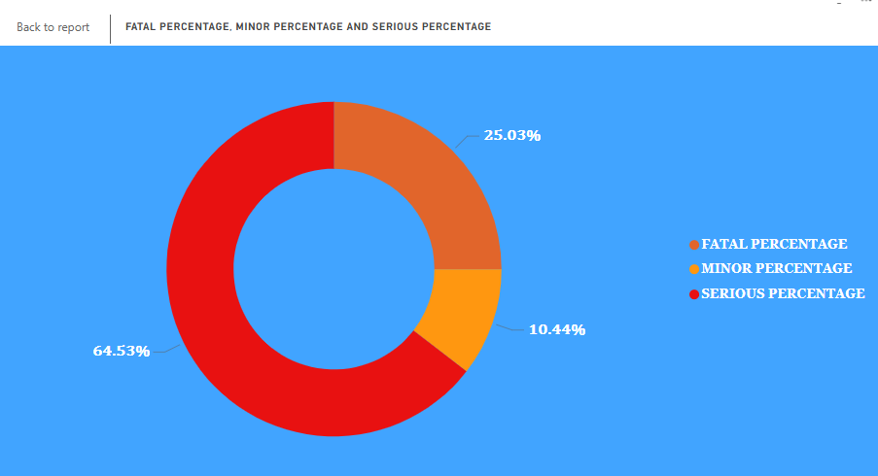
INSIGHT AND VISUALIZATION 6
Fatal, serious and minor relates to severity of injuries sustained from accidents.
Fatal: Accidents that resulted in at least one death.
Serious: Accidents that caused major injuries e.g fractures, head injuries, hospitalization, etc.
Minor: Accidents that led to non-life-threatening injuries e.g cuts, bruises, etc.
From this visual, we can see that 64.53% of accidents are fatal, 25.03% are serious and 10.44% are minor.
The states that contributed the most to the fatal percentage through the years are Bauchi, Niger, FCT, Ogun, Kaduna, Nasarawa, Kano, Oyo, Kogi in no particular order.

Slide 11
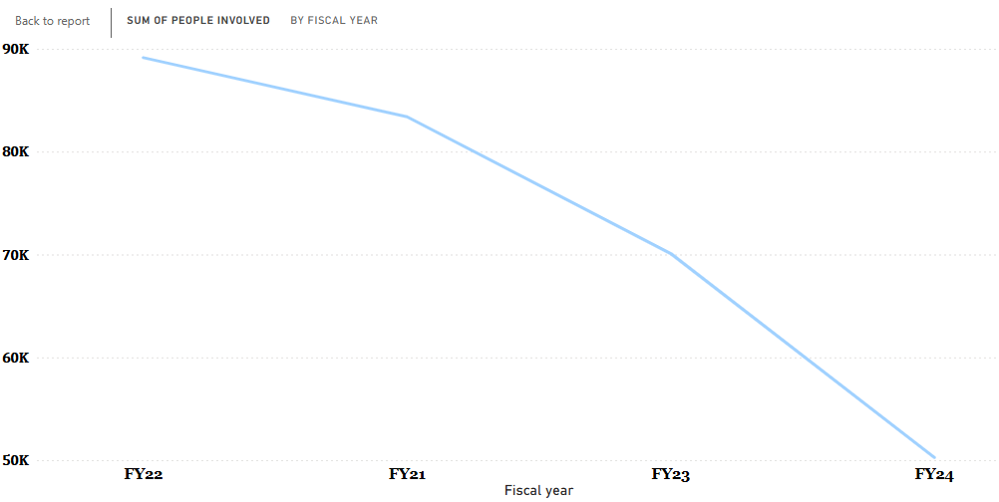
INSIGHT AND VISUALIZATION 7
From this line graph, the year with the highest number of people involved in road accident is 2022, it increased from 83390 in 2021 to 89143 in 2022 and then it took a dip in 2023 to 70091 and futher decreased in 2024 to 50258, bearing in mind that this data ends in Q3 2024. Q4 2022 recorded 3617 crashes higher than prior quarters. Speeding, wrongful overtaking, dangerous driving, night journeys(fatigue), overloading, and mobile phone use are identified as the major causes. Seasonal and regional effects also come in play, the –ember months and zones like North-central , Lagos, etc show spikes.

Slide 12
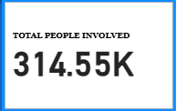
INSIGHT AND VISUALIZATION 8
Total number of people involved in road accidents in Nigeria from Q4 2020 to Q3 2024 was 314,550 people. 21,668 number of people was involved in Q4 2020, in the year 2021 total number of people involved was 83,390, in 2022, 89143 number of people was involved and in 2023, 70091 number of people was involved while in 2024 Q1-Q3, 50258 number of people were involved.

Slide 13
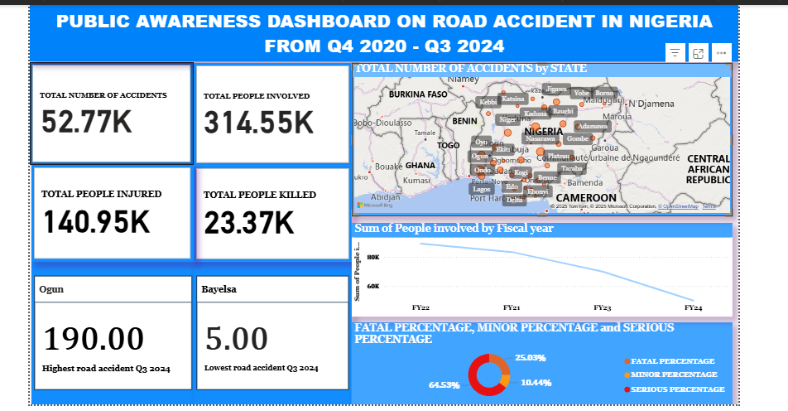
PUBLIC AWARENESS DASHBOARD (1)

Slide 14
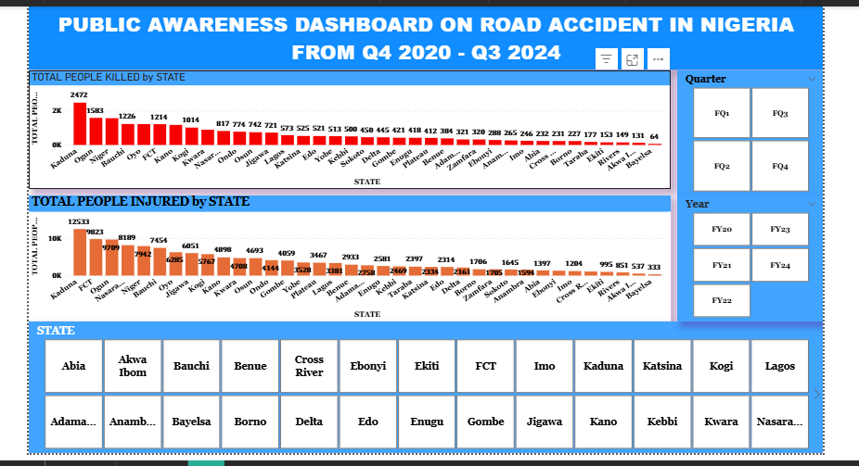
PUBLIC AWARENESS DASHBOARD (2)

Slide 15
CONCLUSION
KEY FINDINGS
-2022 recorded the highest number of people involved in road crashes in the dataset, with increased proportions of serious and fatal injuries.
-The largest proximate contributors were driver behaviors (speeding, wrongful overtaking, fatigue/night driving) and vehicle/road defects.
Geographic and seasonal clustering (ember-month spikes and hotspot states) amplified national totals.
IMPLICATIONS
-Human factors(behavior & enforcement) are the most addressable short-term drivers of crash and fatalities.
-Infrastructure and vehicle maintenance gaps increase crash severity and limit survivability.
PRIORITY RECOMMENDATIONS
-Strengthen targeted enforcement on speed, overtaking and night long-haul trips(high-risks corridor and ember months)
-Launch focused public awareness campaigns on speeding, seat-use and safe overtaking timed before high-risk months.
-Accelerate road repair and signage on identified hotspots; enforce vehicle roadworthiness checks for commercial fleets
-Improve post-crash response (EMS access, trauma stabilization) in high-fatality zones
-Include a data-quality improvement plan; standardize reporting fields and monitor completeness year-over-year

Slide 16
RECOMMENDATIONS
SPEED MANAGEMENT: Enforce speed limiters, automated speed cameras, and speed bumps in high-risk areas.
DRIVER DISCIPLINE: Apply stricter penalties for speeding, dangerous driving, and signal violations.
VEHICL SAFETY: Ensure regular inspections to prevent tyre bursts and brake failures.
ROAD ENGINEERING: Improve signage, lighting, and clear road obstructions to enhance visibility and safety.
PUBLIC AWARENESS: Sustain nationwide campaigns on road safety and responsible driving behavior.
DATA-DRIVEN ENFORCEMENT: Leverage FRSC and GIS data to monitor hotspots and plan targeted interventions.
--Collective enforcement, engineering, and education can significantly reduce road traffic accidents in Nigeria

Slide 17


